Slide 1

ICHIBOSS🐦: Data-Driven Crypto Trading Strategy Evaluation
Welcome to Ichiboss. Our presentation outlines a data-driven approach to evaluating crypto trading strategies.
We provide a developer tool that enables efficient backtesting and optimization. This allows for rigorous analysis and refinement of trading algorithms using historical market data.
Date : 13 April 2025

Slide 2
The Challenge: Efficiently Evaluating Trading Strategies
Problem
Motivation
Manual backtesting is time-consuming and complex.
The crypto market is dynamic and offers trading opportunities.
Existing tools often lack flexibility and diverse data access.
There is a need for developers to quickly evaluate strategies.
Ichiboss addresses these challenges. It provides a streamlined, data-driven backtesting framework.

Slide 3





ICHIBOSS🐦: A Powerful Backtesting Framework
Backtesting Framework
Evaluate strategies against historical data with ease.
Data Integration
Fetch data from CryptoQuant and Glassnode.
Modular Design
Separates data fetching, strategy implementation, and analysis.
Performance Metrics
Provides comprehensive performance reports.
Ichiboss is designed for evaluating cryptocurrency trading strategies. Refine algorithms using historical market data.

Slide 4




System Architecture
Data Fetching
Gather data from CryptoQuant and Glassnode APIs.
Backtesting Framework
Load and preprocess data for strategy execution.
Analysis
Evaluate performance metrics.
Our architecture ensures a clear separation of concerns. It uses external APIs for diverse data and scalable design.

Slide 5
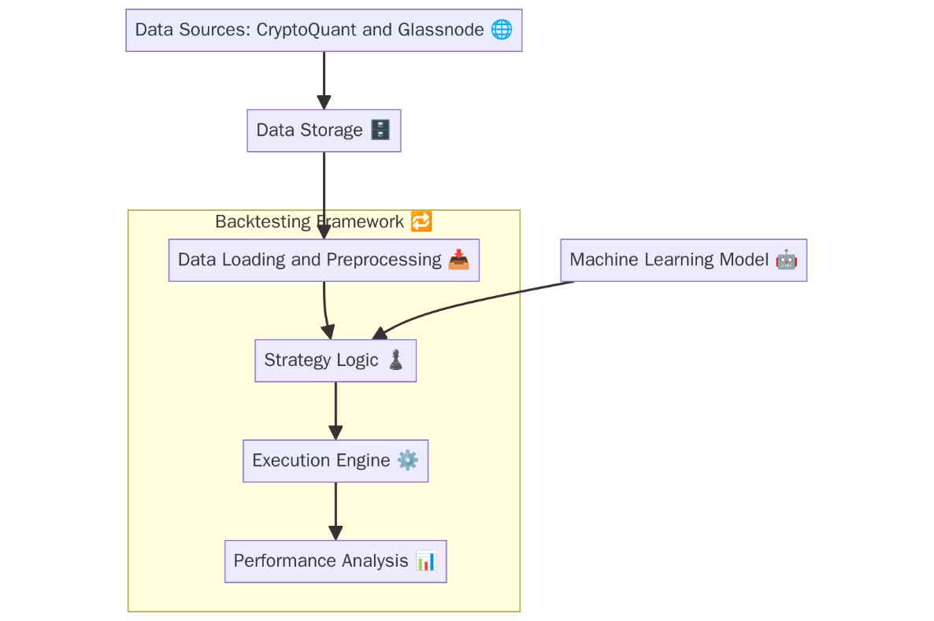
ICHIBOSS🐦 System Architecture

Slide 6
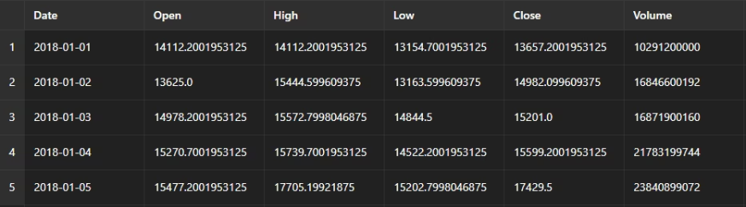
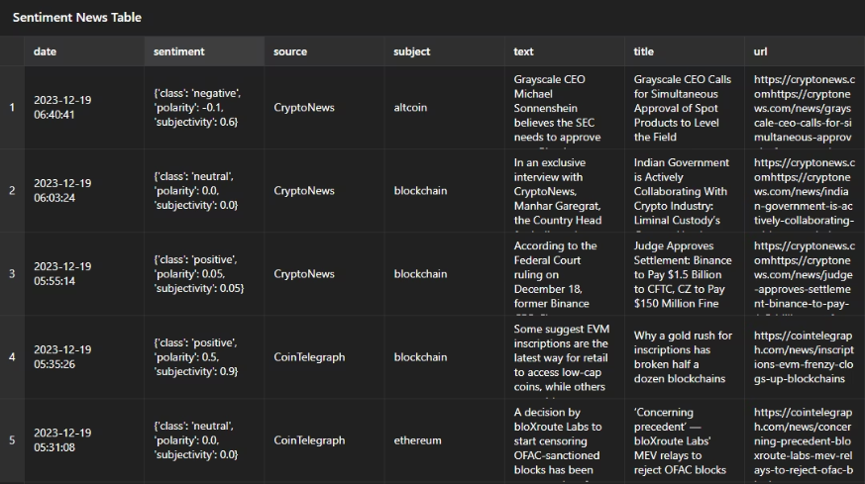
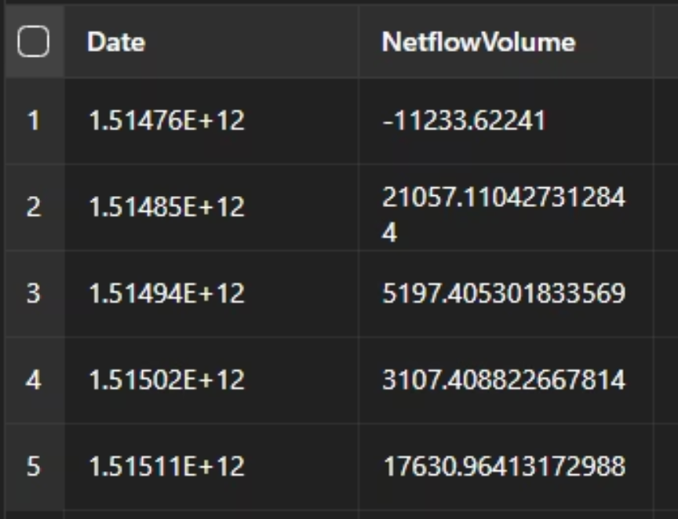
Data Collection and Preprocessing
btc_data.csv
cryptonews.csv
netflow.csv

Slide 7
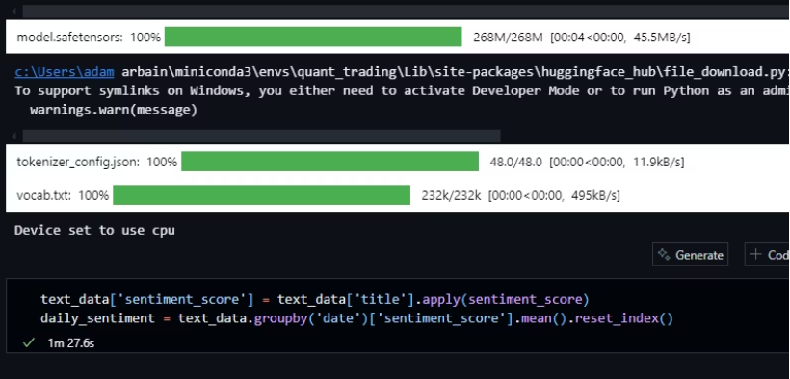
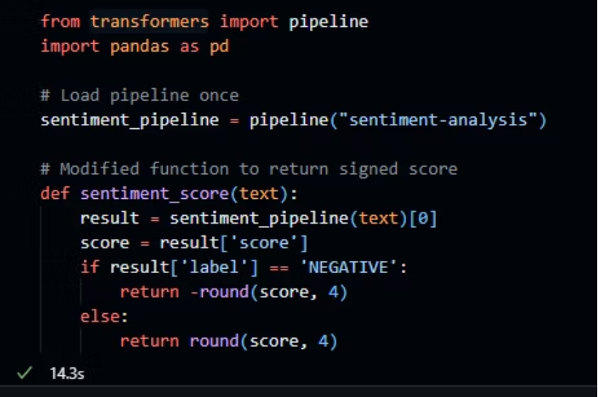
Machine Learning Model
Implementing sentiment analysis using NLP

Slide 8
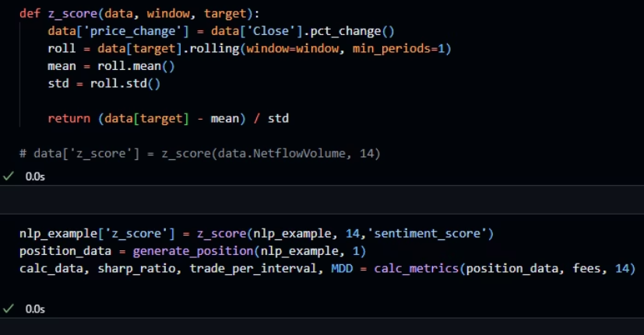
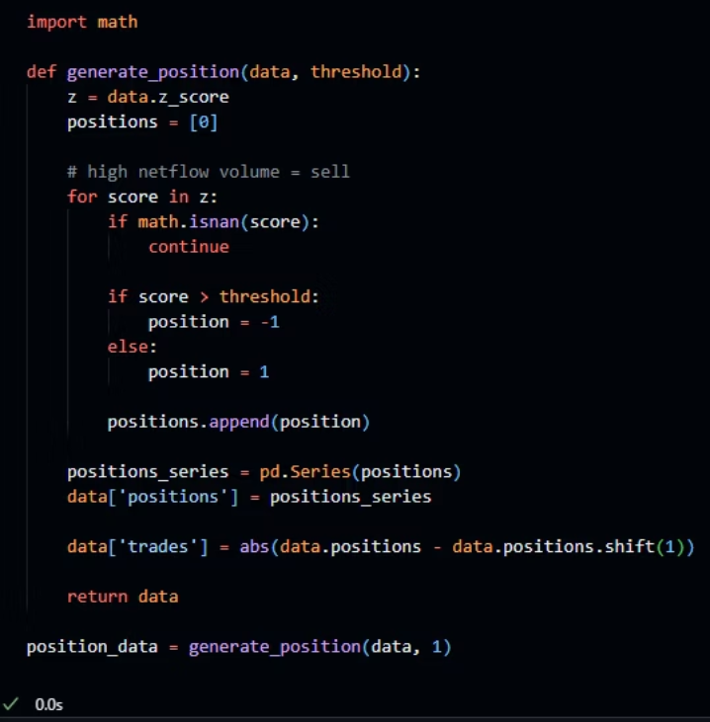
Strategy Logic
generate_position(data, threshold)
Future Work :
Make a parallel function to run threshold optimization.

Slide 9
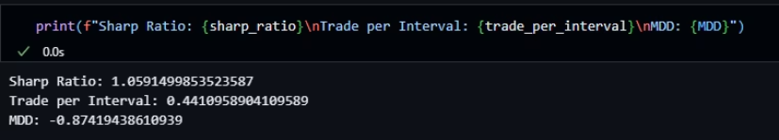
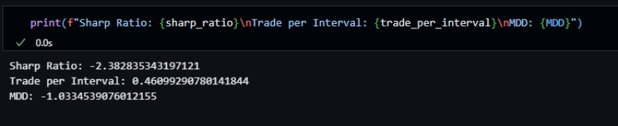
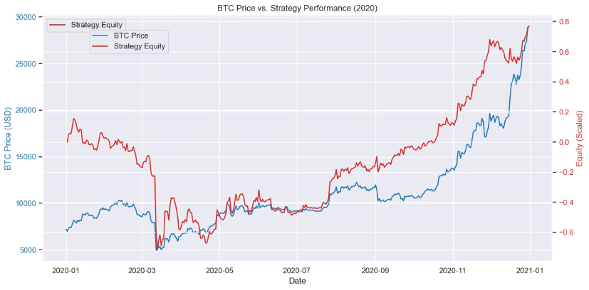
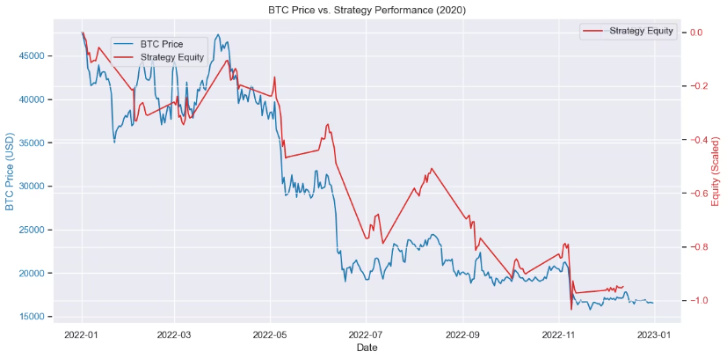
Performance Metrics
Strategy based on Z-Score
Sentiment Analysis Strategy based on cryptonews.csv

Slide 10



Innovation and Originality
Modular Framework
2
Flexibility to test custom strategies.
Data Integration
1
Unique crypto data from CryptoQuant, Glassnode.
Cryptocurrency Focus
Addresses specific crypto market characteristics.
3
Our innovation lies in specialized data integration. We offer a modular framework tailored for cryptocurrency markets.

Slide 11
Technical Execution and Feasibility
Prototype
1
Demonstrates core backtesting functionality.
Modular Design
2
Promotes maintainability and extensibility.
Jupyter Notebooks
3
Interactive and user-friendly experience.
Our system can be deployed in real-world scenarios. It provides an interactive and user-friendly experience.

Slide 12




Presentation, Communication and Team
Clear Explanation
Concise explanation of the problem, solution, and impact
Engaging Visuals
Well-structured and easy-to-follow narrative
Team Collaboration
Briefly describe team roles and how the team worked together
We deliver a clear explanation of our solution. We worked together effectively to produce Ichiboss.

Slide 13
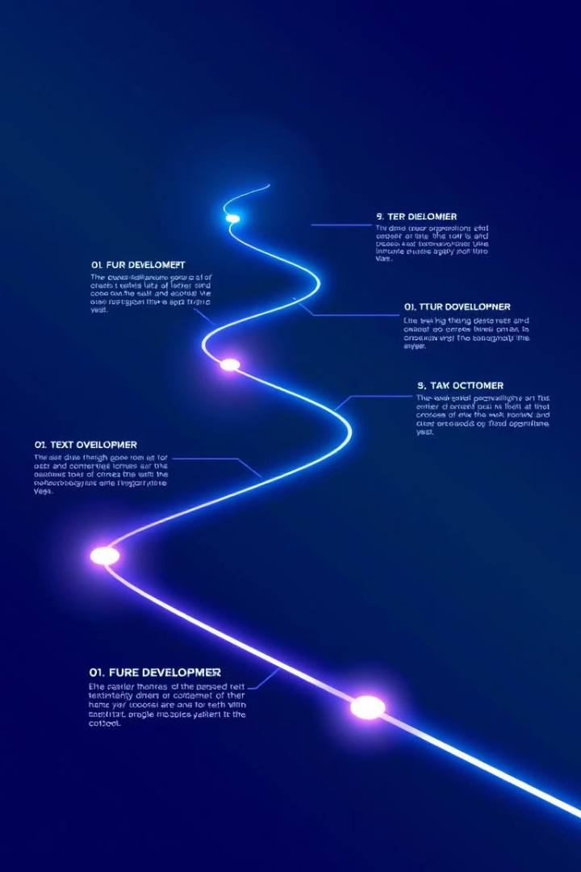
Conclusion and Future Work
Conclusion
Ichiboss is a valuable tool for optimizing crypto trading strategies.
Future Work
Integrate more data sources.
Develop advanced strategies.
Implement real-time backtesting.
Ichiboss leverages data sources and offers a flexible architecture. We plan to enhance the UI and explore machine learning.

Slide 14
THE END
Thank You for your attention :)
Questions and Anwsers Session

